Slide 1

The Research Question
Specifying the Research Question or Hypothesis

Slide 2

The Research Question
So you observe something of interest and you ask yourself Why?

Slide 3
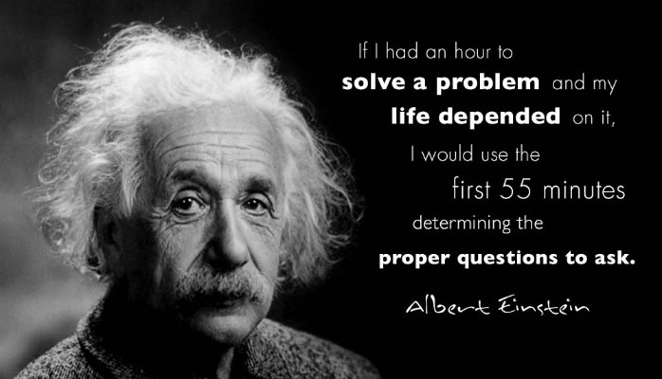
The Research Question

Slide 4
The Research Question
Not only do you have to ask the right question, but the question needs to be worded in such a way that it can answered through research.

Slide 5
The Research Question
For example: “Do children learn better using computers?” does not make a good research question.
Is agile methodology a better software development method?

Slide 6
The Research Question
Also the way the question is worded will depend on the research method you wish to employ. But generally the question comes first then the research method.

Slide 7
The Research Question
For example: “Do children learn better using computers?” does not make a good research question.
Is the agile method a better software development method?

Slide 8

The Research Question
In both quantitative and qualitative research
The research question narrows arena to specific questions that researchers seek to answer.

Slide 9
The Research Question
In quantitative research the questions relate attributes or characteristics of individuals or organisations.
In qualitative research the questions include a central concept being explored.

Slide 10
The Research Question
Research Question: an example
Quantitative Research
“Do parent-teacher Internet communications affect student performance in the classroom?”
Qualitative Research
“What types of Internet experiences of parents have with teachers about the performance of the parents children?”

Slide 11
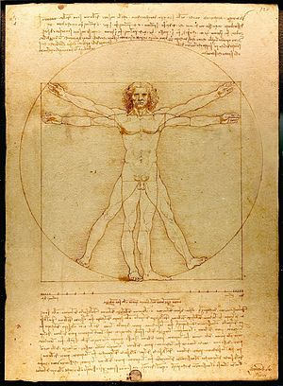
The Research Question
The Vitruvian Man is a drawing created by Leonardo De Vinci circa 1490.
The drawing and text are sometimes called the Canon of Proportions.

Slide 12
The Research Question
Variables
To carryout any quantitative research you need to have identified the main variables.
A variable is a characteristic or attribute of an individual or an organisation that (a) researchers can measure or observe and (b) varies among individuals and organisations being studied.

Slide 13
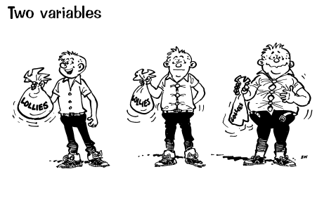
The Research Question
Variables
Subjects scores will vary, hence the term variable.

Slide 14
The Research Question
Theories and hypothesis
In quantitative research we seek to test whether the independent variable influences the outcome or dependent variable.
A theory in quantitative research explains and predicts the probable relationship between dependent and independent variables.

Slide 15
The Research Question
Theories and hypothesis
This relationship is tested over and over, with different scenario's, repeatedly similar results are shown. Then someone calls this relationship a theory, this is reported in the literature and then researchers test that theory.
Theories are just broad explanations as to what we would expect to find when we relate variables

Slide 16
The Research Question
Theories and hypothesis
Also there is the Null hypothesis.
Null Hypothesis makes predictions that of all the possible people whom researchers might study there is no relationship between the independent and dependent variables

Slide 17
The Research Question
Theories and hypothesis:
Null hypothesis No relationship
Alternative Hypothesis There is a relationship, if the relationship is true then you reject the null hypothesis.

Slide 18
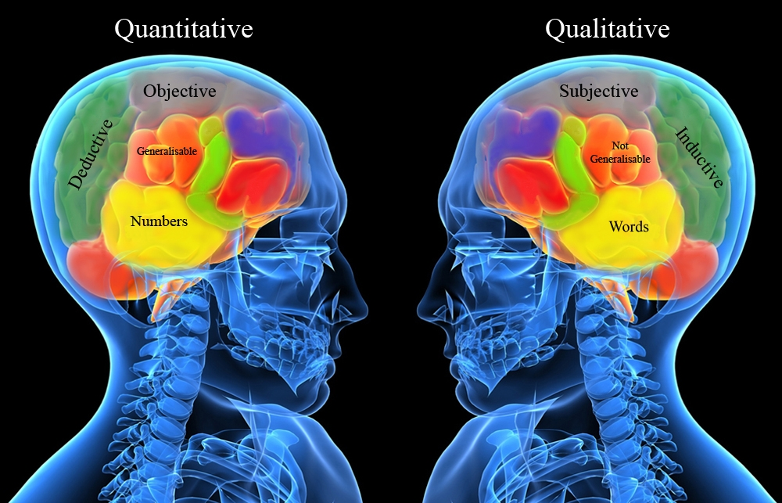
Qualitative Purpose Statements
In this part we will be looking at Qualitative Research

Slide 19
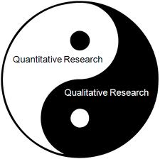
Qualitative Purpose Statements
We need to be clear about the difference between quantitative and qualitative research. The application differs depending on which you conduct.

Slide 20
Qualitative Purpose Statements
Quantitative
Uses Hypothesis
Multiple Variables
Test Theories
Closed ended stance
Deductive
Measure differences
Qualitative
Hypothesis not used
Single concept
General themes
Open ended stance
Inductive
Understanding of views

Slide 21

Qualitative Purpose Statements
Qualitative Research
Central component of the research question in qualitative research is the central Phenomenon

Slide 22

Qualitative question
Qualitative Research
The point with qualitative research questions are that they don’t seek to quantify. They are more concerned with how organizations and individuals operate. The response are generally not numeric, but can consist of opinions and thoughts about the central phenomenon

Slide 23
Qualitative Purpose Statements
The central phenomenon is a concept or process explored in qualitative research.
i.e. Who identify as ethnic Maori in New Zealand?

